Slide 1


Analog and Digital Fundamentals
GM University
Davanagere
Operational Amplifiers and Applications
Notes:
GM University

Slide 2
Operational Amplifiers
An operational amplifier, or op-amp, is the most important and versatile analog IC
It is a direct coupled multistage voltage amplifier with an extremely high gain
With the help of opamp, the circuit design becomes very simple
The variety of useful circuits can be built without the necessity of knowing about the complex internal circuitry

Slide 3
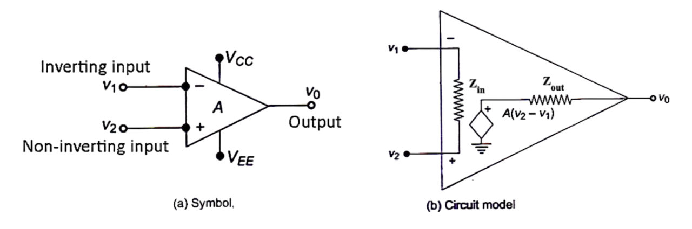
Operational Amplifiers
Circuit symbol and model of an op-amp

Slide 4
Operational Amplifiers
An op-amp has two input terminals – an inverting input 𝑉1 and a non-inverting input 𝑉2, and an output 𝑉𝑜.
It requires two power supplies: +𝑉𝐶𝐶 and −𝑉𝐸𝐸.
It has a very high input impedance 𝑍𝑖𝑛, a very low output impedance 𝑍𝑜𝑢𝑡 and a very high gain 𝐴.

Slide 5
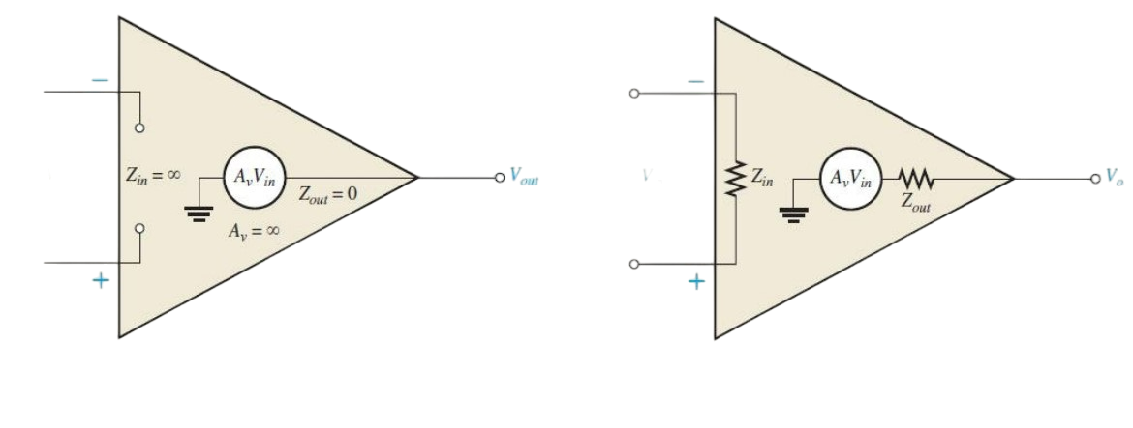
Ideal and Practical Op-Amp
Ideal op-amps
Practical op-amps
Representation of ideal and practical op-amps

Slide 6
Characteristics of Ideal Op-Amps
Characteristics of a ideal op-amp are:
Infinite voltage gain and infinite bandwidth
Infinite input impedance
Zero output impedance
Zero Input offset voltage and zero input offset current
Infinite CMRR(Common Mode Rejection Ratio) and Slew rate

Slide 7
Characteristics of Practical Op-Amps
Characteristics of a practical op-amp are:
Very high voltage gain,
Very high input impedance, and
Very low output impedance.

Slide 8
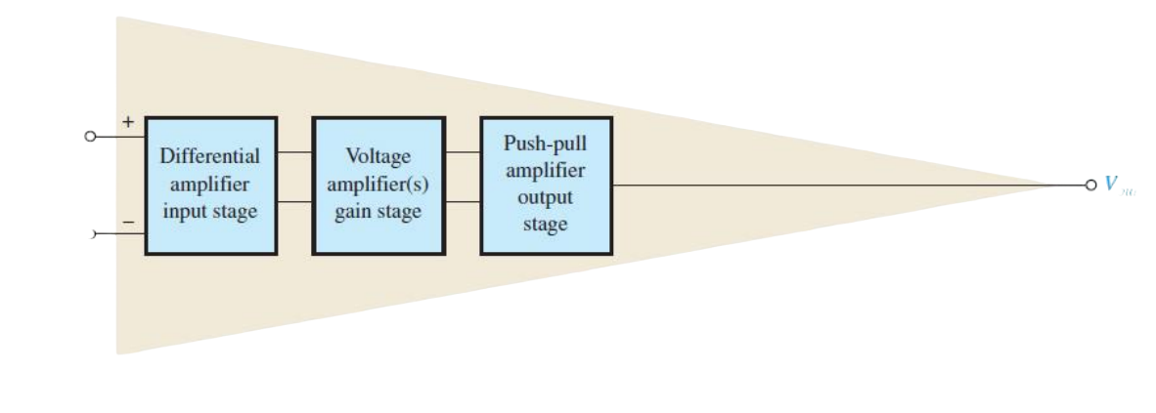
Internal Block Diagram of an Op-Amp
A typical op-amp is made up of three types of amplifier circuits:
a differential amplifier, a voltage amplifier, and a push-pull amplifier, as shown in Fig
Vin
Vout

Slide 9
Internal Block Diagram of an Op-Amp
• The differential amplifier is the input stage for the op-amp. It provides amplification of the difference voltage between the two inputs.
• The second stage is usually a class A amplifier that provides additional gain. Some op-amps may have more than one voltage amplifier stage.
• A push-pull class B amplifier is typically used for the output stage.

Slide 10
Op-Amp Input Methods
Differential Method:
In the differential mode, either one signal is applied to an input with the other input grounded or two opposite-polarity signals are applied to the inputs.
It has 2 types: a. Single-Ended Differential method
b. Double-Ended Differential method
2. Common Mode

Slide 11
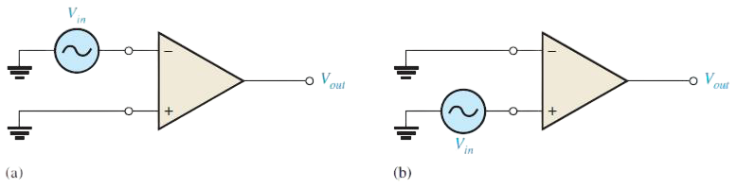
Single-Ended Differential Method
When an op-amp is operated in the single-ended differential mode, one input is grounded and a signal voltage is applied to the other input, as shown in Fig
Single-ended differential mode

Slide 12
Single-Ended Differential Method
In the case where the signal voltage is applied to the inverting input as in Fig. (a), an inverted, amplified signal voltage appears at the output.
In the case where the signal is applied to the noninverting input with the inverting input grounded, as in Fig. (b), a non-inverted, amplified signal voltage appears at the output.

Slide 13
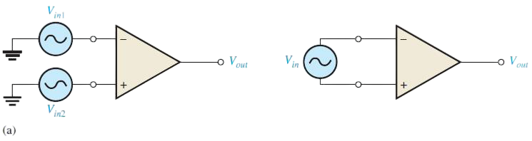
Double-Ended Differential Method
In the double-ended differential mode, two opposite-polarity (out-of-phase) signals are applied to the inputs, as shown in Fig. (a). The amplified difference between the two inputs appears on the output.
Double-ended differential mode
Equivalently, the double-ended differential mode can be represented by a single source connected between the two inputs, as shown in right side figure

Slide 14
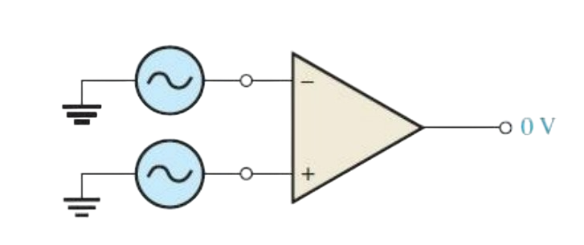
Common Mode
In the common mode, two signal voltages of the same phase, frequency, and amplitude are applied to the two inputs, as shown in Fig.
Vin
0 V
Vin
Common mode operation

Slide 15
Common Mode
When equal input signals are applied to both inputs, they tend to cancel, resulting in a zero output voltage. This action is called common-mode rejection.
Its importance lies in the situation where an unwanted signal appears commonly on both op-amp inputs.
Common-mode rejection means that this unwanted signal will not appear on the output and distort the desired signal.

Slide 16
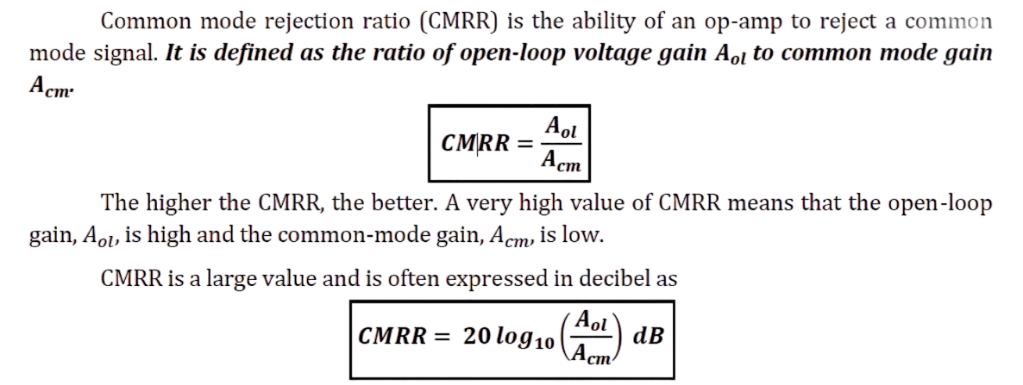
OpAmp Parameters
Common Mode Rejection Ratio

Slide 17
OpAmp Parameters
Maximum Output Voltage Swing (𝑽𝑶(𝒑−𝒑))
With no input signal, the output of an op-amp is ideally 0 V. This is called the quiescent output voltage.
When an input signal is applied, the ideal limits of the peak-to-peak output signal are ±𝑉𝐶𝐶.
In practice, however, this ideal can be approached but never reached. 𝑉𝑂(𝑝−𝑝) varies with the load connected to the op-amp and increases directly with load resistance.

Slide 18
OpAmp Parameters
Input Offset Voltage
The ideal op-amp produces zero volts out for zero volts in. In a practical op-amp, a small dc voltage appears at the output when no differential input voltage is applied.
The input offset voltage, 𝑉𝑂𝑆, is the differential dc voltage required between the inputs to force the output to zero volts.
Typical values of input offset voltage are in the range of 2 mV or less. In the ideal case, it is 0 V.

Slide 19
OpAmp Parameters
Input Offset Current
Ideally, the two input bias currents are equal, and thus their difference is zero. In a practical op-amp, however, the bias currents are not exactly equal.
The input offset current, 𝐼𝑂𝑆, is the difference of the input bias currents, expressed as an absolute value.
𝑰𝑶𝑺=|𝑰𝟏−𝑰𝟐|

Slide 20
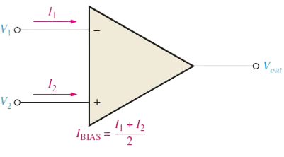
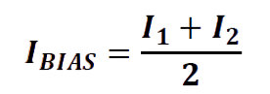
OpAmp Parameters
Input Bias Current
The input bias current is the average of the two input currents of the op-amp. It is calculated as follows:
It is the dc current required by the inputs of the amplifier to properly operate the first stage. The concept of input bias current is illustrated in Fig.

Slide 21
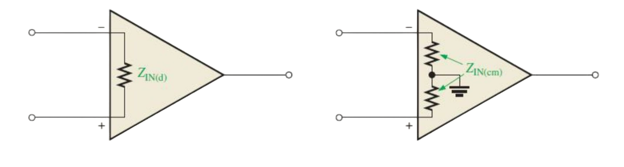
OpAmp Parameters
Input Impedance
Two basic ways of specifying the input impedance of an op-amp are the differential and the common mode.
a) Differential Input Impedance b) Common-mode Input Impedance

Slide 22
OpAmp Parameters
Input Impedance
The differential input impedance is the total resistance between the inverting and the noninverting inputs, as illustrated in Fig. (a). It is measured by determining the change in bias current for a given change in differential input voltage.
The common-mode input impedance is the resistance between each input and ground and is measured by determining the change in bias current for a given change in common-mode input voltage. It is depicted in Fig. (b).

Slide 23
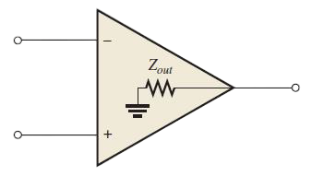
OpAmp Parameters
Output Impedance
The output impedance is the resistance viewed from the output terminal of the op-amp, as indicated in Fig.
Op-amp output impedance

Slide 24
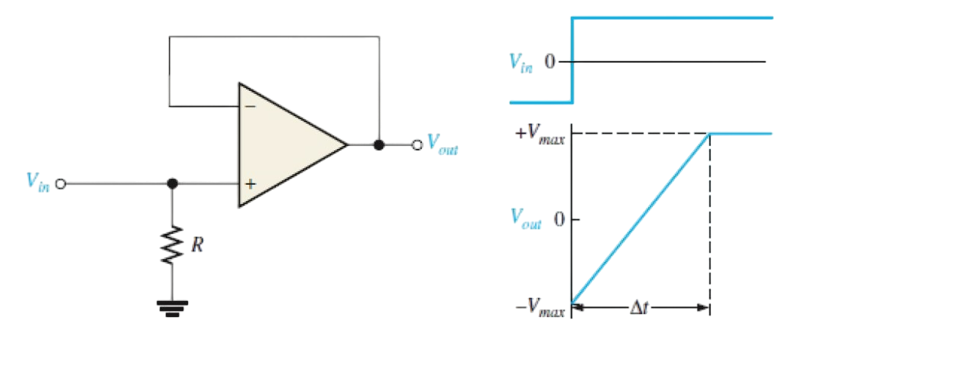
OpAmp Parameters
Slew Rate
Slew rate is defined as the maximum rate of change of output voltage in response to a step input voltage.
Test Circuit b) Step input voltage and resulting output voltage

Slide 25
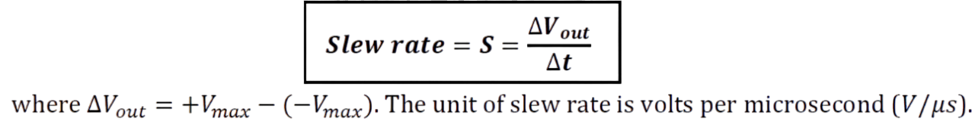
OpAmp Parameters
Slew Rate
Slew rate is measured with an op-amp connected as shown in Fig.(a).
A pulse is applied to the input and the resulting ideal output voltage is indicated in Fig.(b).
The width of the input pulse must be sufficient to allow the output to “slew” from its lower limit to its upper limit. A certain time interval Δ𝑡 is required for the output voltage to go from its lower limit −𝑉𝑚𝑎𝑥 to its upper limit +𝑉𝑚𝑎𝑥 once the input step is applied.

Slide 26
Analog and Digital Fundamentals
GM University
Davanagere
Operational Amplifiers and Applications - Basic OpAmp Circuits
Notes:
GM University

Slide 27
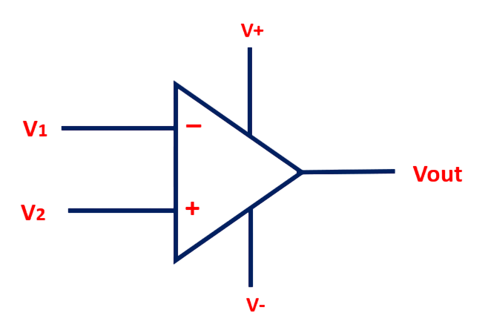
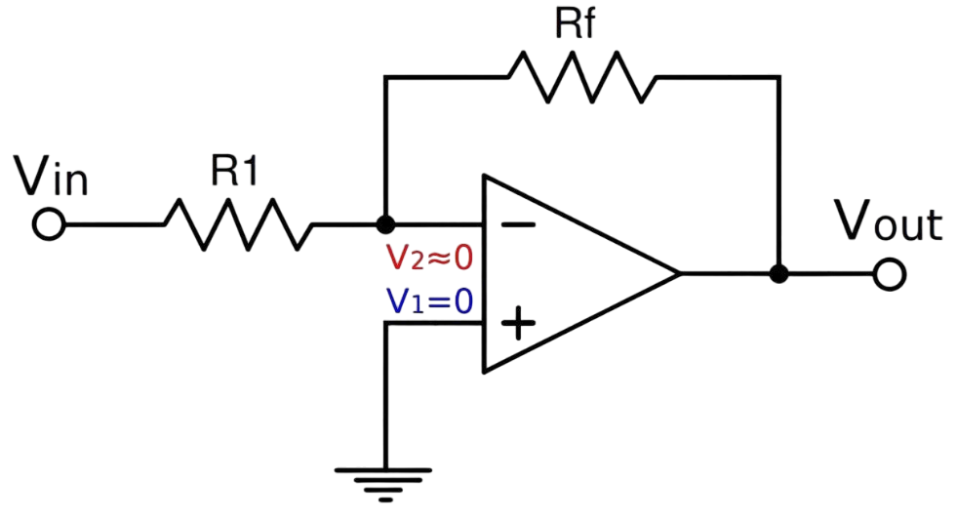
Virtual ground (or) Virtual Short Circuit
Vout = A (V2-V1)
Fig (a) Output of OpAmp Fig(b) Virtual ground

Slide 28
Virtual ground (or) Virtual Short Circuit
Virtual Ground: An ideal op-amp has an infinite gain. We know that output voltage 𝑉𝑜=𝐴(𝑉2−𝑉1).
That makes
(𝑉2−𝑉1)= (𝑉𝑜 / 𝐴).
If gain 𝐴 is infinite (because Voltage gain A = infinite for Ideal OpAmp), that means the difference
(𝑉2−𝑉1)=0, or 𝑉1=𝑉2.
(Because any number divided by infinity is equal to zero)
This means that the input terminals of an op-amp are always at the same potential. Thus, if one terminal is grounded, the other one can be treated to be virtually grounded ( Fig(b)).
Zero Input Current: Since the input resistance of an ideal op-amp is infinite, no current flows into an op-amp. This makes the input current zero, I1= I2 = 0.

Slide 29
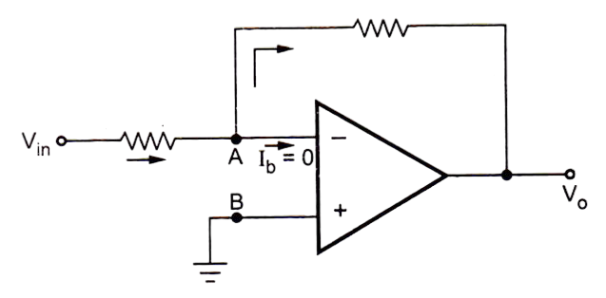
OpAmp as Inverting Amplifier
An amplifier which produces a phase shift of 180° between input and output is called inverting amplifier. Fig. shows an inverting amplifier using op-amp.
Rf
If
R1
I1

Slide 30
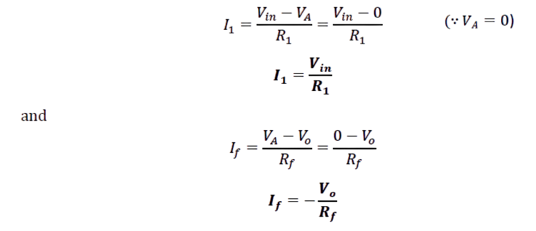
OpAmp as Inverting Amplifier
From the circuit, the potential at node B, 𝑉𝐵=0.
From the concept of virtual ground, the two input terminals are at same potential. Therefore, the potential at node A,
𝑉𝐴=𝑉𝐵=0.
From the circuit,

Slide 31
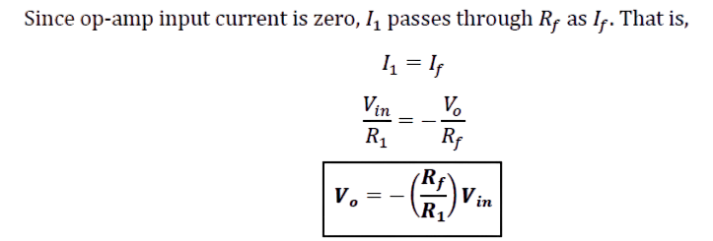
OpAmp as Inverting Amplifier
Here (𝑅𝑓/𝑅1) is called the gain of the amplifier and negative sign indicates that the output is inverted.

Slide 32
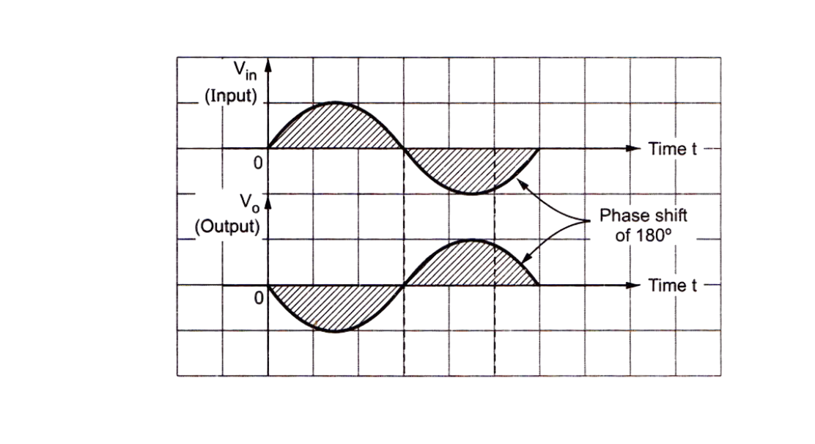
OpAmp as Inverting Amplifier
Waveforms of Inverting Amplifier

Slide 33
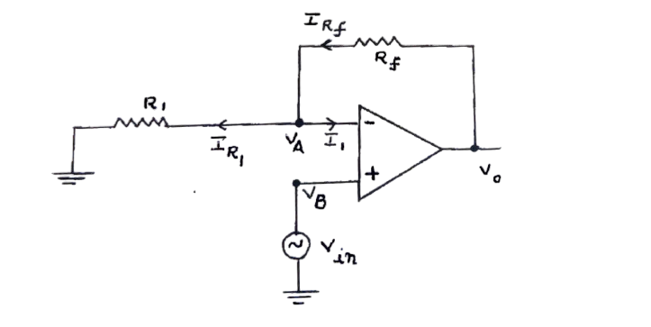
OpAmp as Non Inverting Amplifier
An amplifier which amplifies the input without producing any phase shift between input and output is called non-inverting amplifier. Fig shows a non-inverting amplifier using op-amp.
A
B

Slide 34
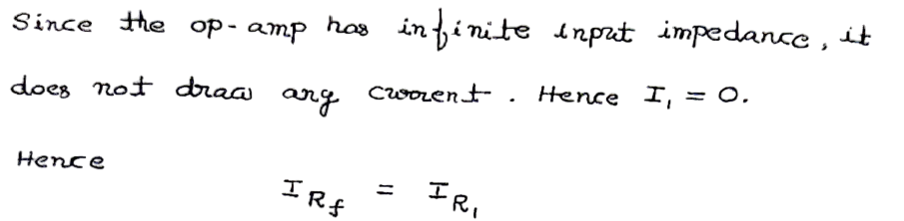
OpAmp as Non Inverting Amplifier
From the circuit, the potential at node B, 𝑉𝐵=𝑉𝑖𝑛.
From the concept of virtual ground, the two input terminals are at same potential.
Therefore, the potential at node A, 𝑉𝐴=𝑉𝐵=𝑉𝑖𝑛.

Slide 35
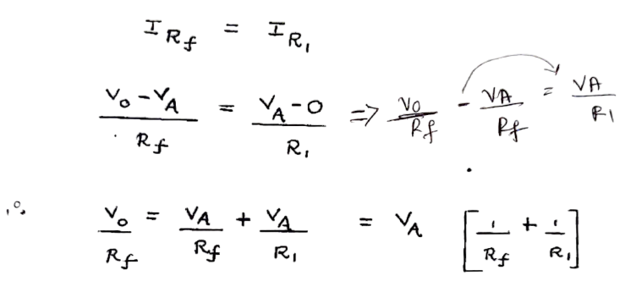
OpAmp as Non Inverting Amplifier

Slide 36
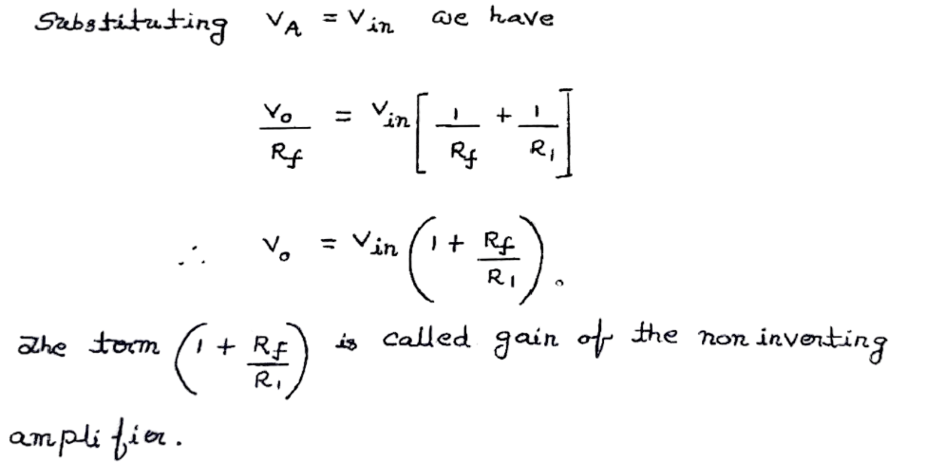
OpAmp as Non Inverting Amplifier

Slide 37
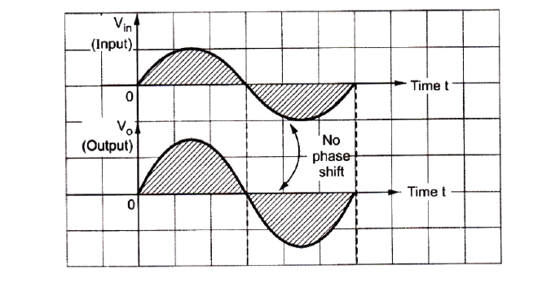
OpAmp as Non Inverting Amplifier
Waveforms of Non Inverting Amplifier

Slide 38
Analog and Digital Fundamentals
GM University
Davanagere
Operational Amplifiers and Applications - Linear Applications of OpAmps
Notes:
GM University

Slide 39
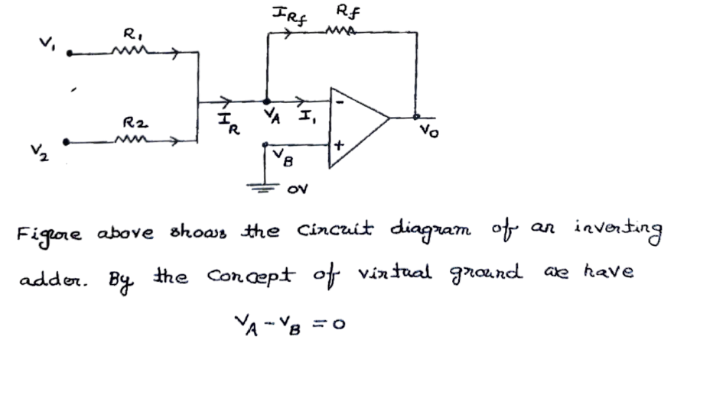
OpAmp as an Inverting adder (Summer)

Slide 40
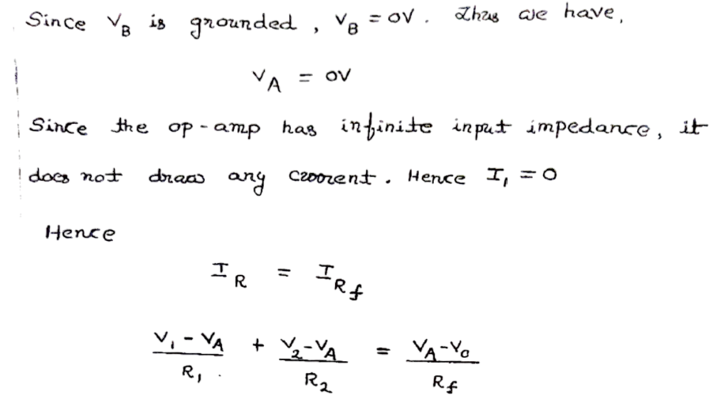
OpAmp as an Inverting adder (Summer)

Slide 41
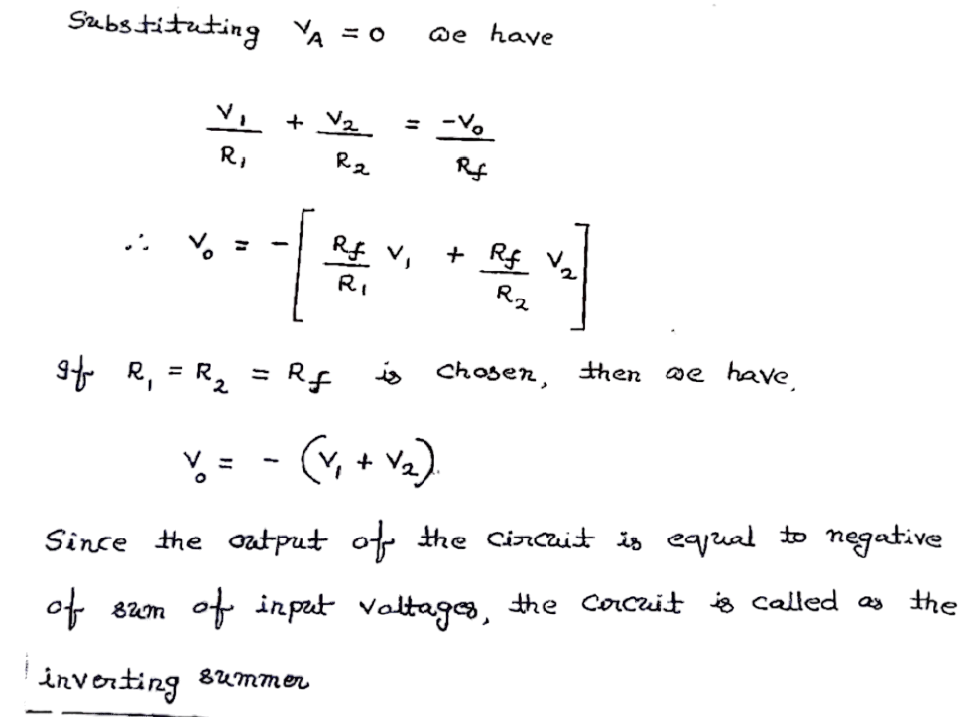
OpAmp as an Inverting adder (Summer)

Slide 42
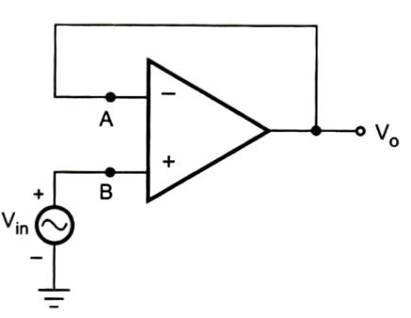
OpAmp as Voltage Follower
A circuit in which the output voltage follows the input voltage is called voltage follower. Fig. shows a voltage follower circuit using an op-amp

Slide 43
OpAmp as Voltage Follower
the circuit, the potential at node B,
𝑉𝐵=𝑉𝑖𝑛.
From the concept of virtual ground, the two input terminals are at same potential.
Therefore, the potential at node A,
𝑉𝐴=𝑉𝐵=𝑉𝑖𝑛.
The node 𝐴 is directly connected to the output.
Hence
𝑉𝑜=𝑉𝐴
Now since
𝑉𝐴=𝑉𝑖𝑛,
𝑽𝒐=𝑽𝒊𝒏
Thus, the output voltage is equal to the input voltage.

Slide 44
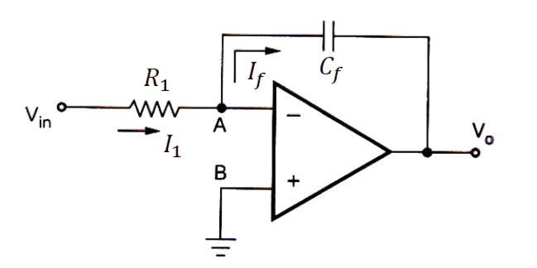
OpAmp as Integrator
In an integrator circuit, the output is the integration of the input voltage. Fig. shows an integrator circuit using an op-amp.

Slide 45
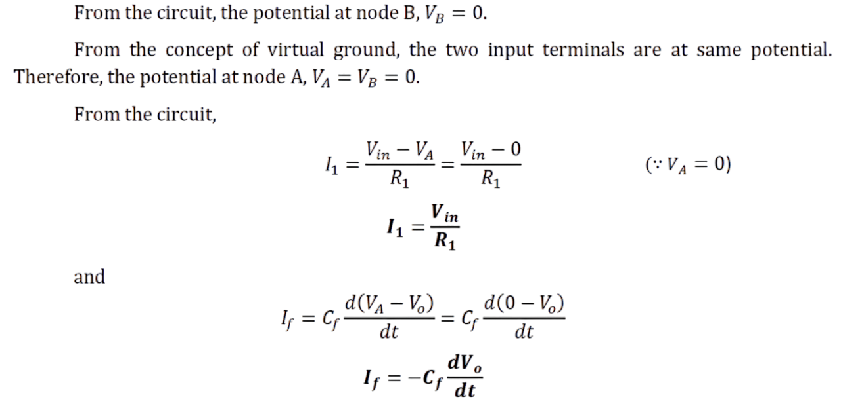
OpAmp as Integrator

Slide 46
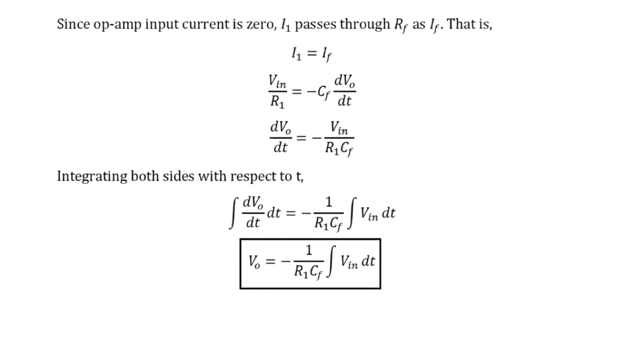
OpAmp as Integrator

Slide 47
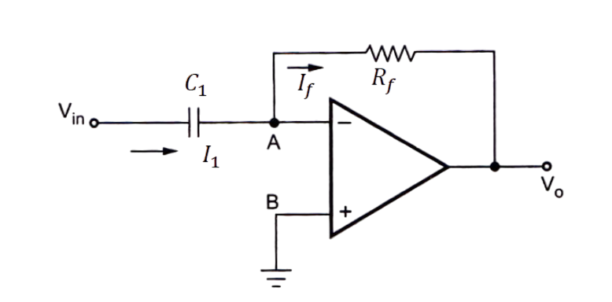
OpAmp as Differentiator
In a differentiator circuit, the output is the differentiation of the input voltage. Fig. shows a differentiator circuit using an op-amp.

Slide 48
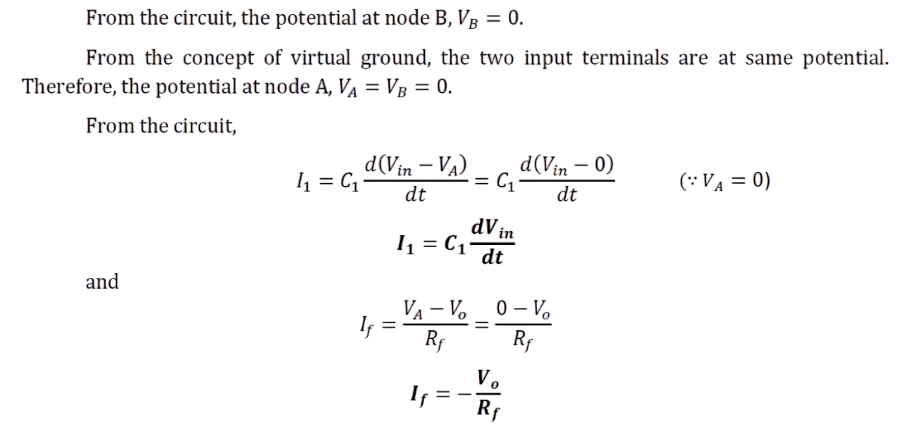
OpAmp as Differentiator

Slide 49
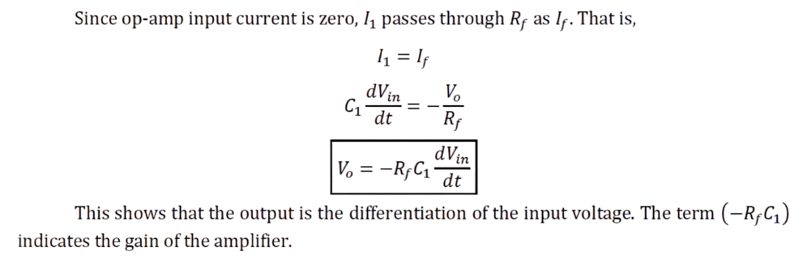
OpAmp as Differentiator

Slide 50
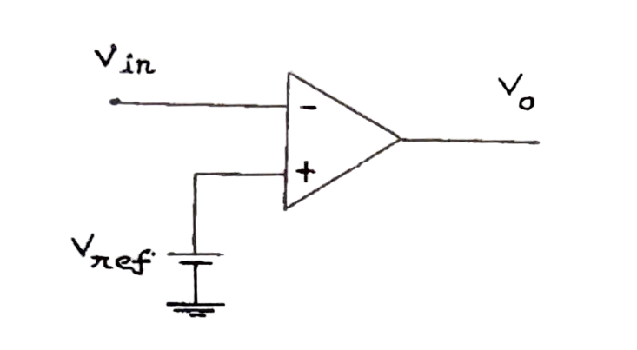
OpAmp as Comparator
In a comparator circuit, which compares a signal voltage applied at one point of the op amp with a known reference voltage at other input.
Figure shows the circuit diagram of an inverting comparator with the reference voltage Vref applied at the non inverting input. The input signal is applied at the inverting input.

Slide 51
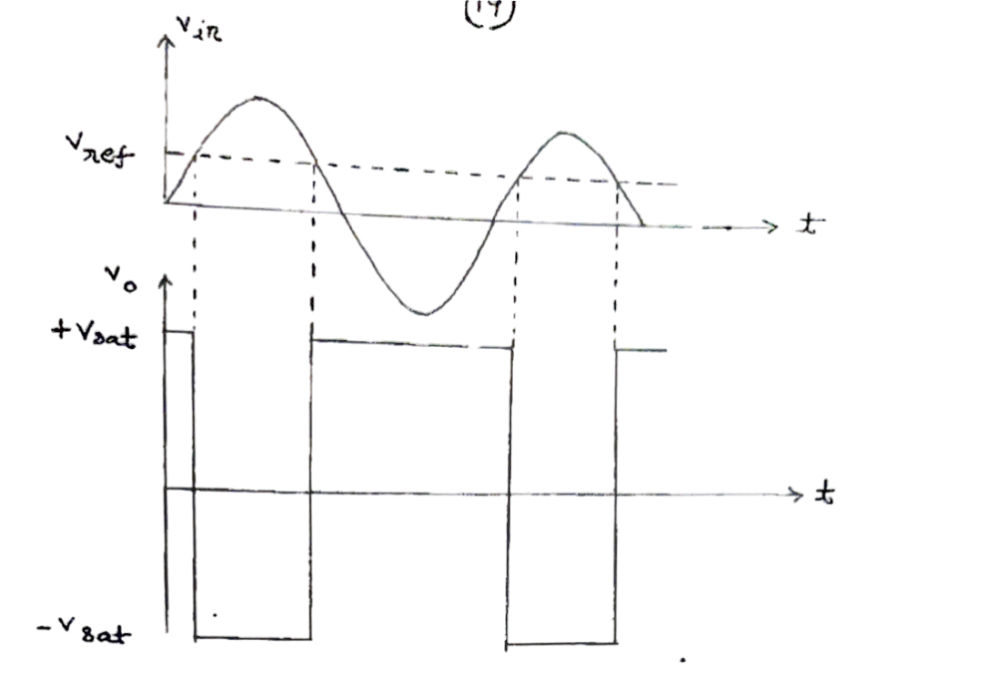
OpAmp as Comparator
When the input voltage Vin is greater than the reference voltage Vref, The output voltage is maximum negative level -Vsat( ≃-Vcc)
When the input voltage Vin is less than the reference voltage Vref, The output voltage is maximum positive level +Vsat( ≃+Vcc)
The input and output waveforms are as shown in the beside figure for Vref > 0

Slide 52
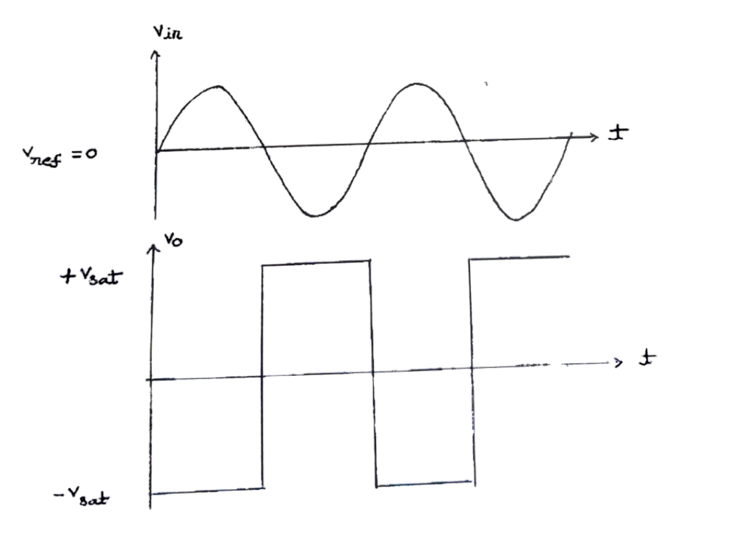
OpAmp as Comparator
When Vref is set to zero, the comparator is called zero crossing detection . The input and output waveforms are as shown below.

Slide 53
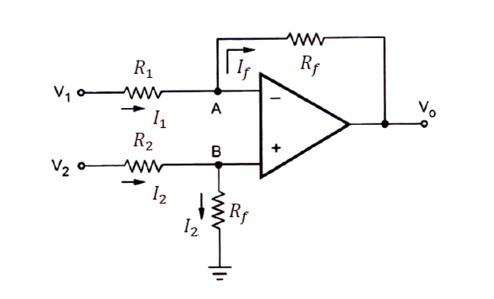
OpAmp as Subtractor
In a subtractor circuit, the output is the difference between the two inputs. Fig. shows a subtractor circuit using an op-amp.

Slide 54
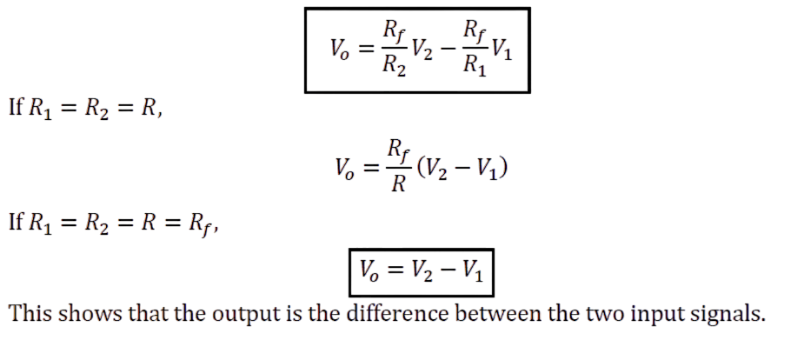
OpAmp as Subtractor

Slide 55
Thank you

